Slide 1
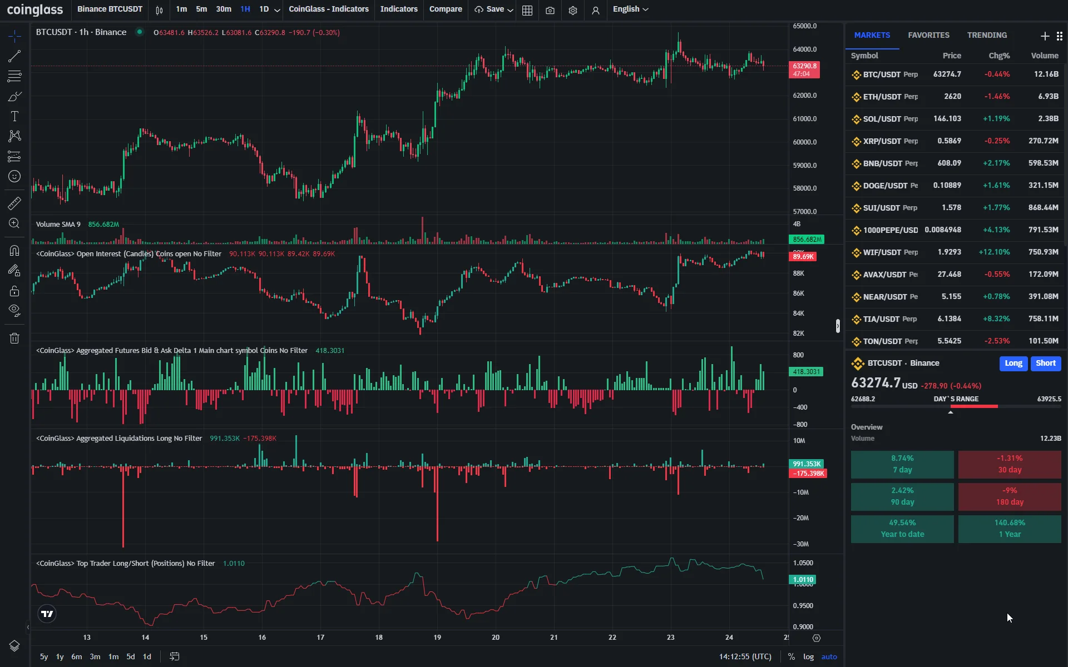
COIN HOOD
Poorna Chandra Dinesh
Uma Maheswari

Slide 2
Java-Based Crypto Trading Platform
Objective: To build a secure and intelligent cryptocurrency trading platform.
Tech Stack:
Frontend: React.js
Backend: Spring Boot (Java)
API: CoinGecko for real-time crypto data
AI Integration: Gemini AI for user insights and predictions
Key Features: Live crypto tracking, trading UI, intelligent analysis.

Slide 3
System Architecture
Frontend (React.js): User interface, real-time charts, order forms.
Backend (Spring Boot): REST APIs, authentication, trade logic.
CoinGecko API: Fetching market data, historical prices.
Gemini AI: Analyzing patterns, offering trade suggestions.
Architecture diagram
[React.js Frontend] ⇄ [Spring Boot Backend] ⇄ [Coin-Gecko API & Gemini AI]

Slide 4
Core Features of the Platform
Live Market Dashboard – Real-time price updates.
Crypto Trading – Buy/sell mock trading.
Portfolio Tracking – View holdings, gains/losses.
Secure Login & Role Management – Built with Spring Security.

Slide 5
Development Challenges & Solutions
For Real-time data handling
Used React hooks + polling/websockets.
For Integrating AI for meaningful insights
Fine-tuned Gemini AI to user portfolio and trends.
For Secure API and user sessions
Used JWT and Spring Security.

Slide 6
What's Next?
Planned Features:
Real Exchange Trading
Integration with live exchanges like Binance or Gemini for real-time transactions.
Price Alert Notifications
Email/SMS/Push alerts when selected assets hit target prices.
Mobile App Version
Expanding to iOS/Android for on-the-go trading and tracking.

